Slide 1
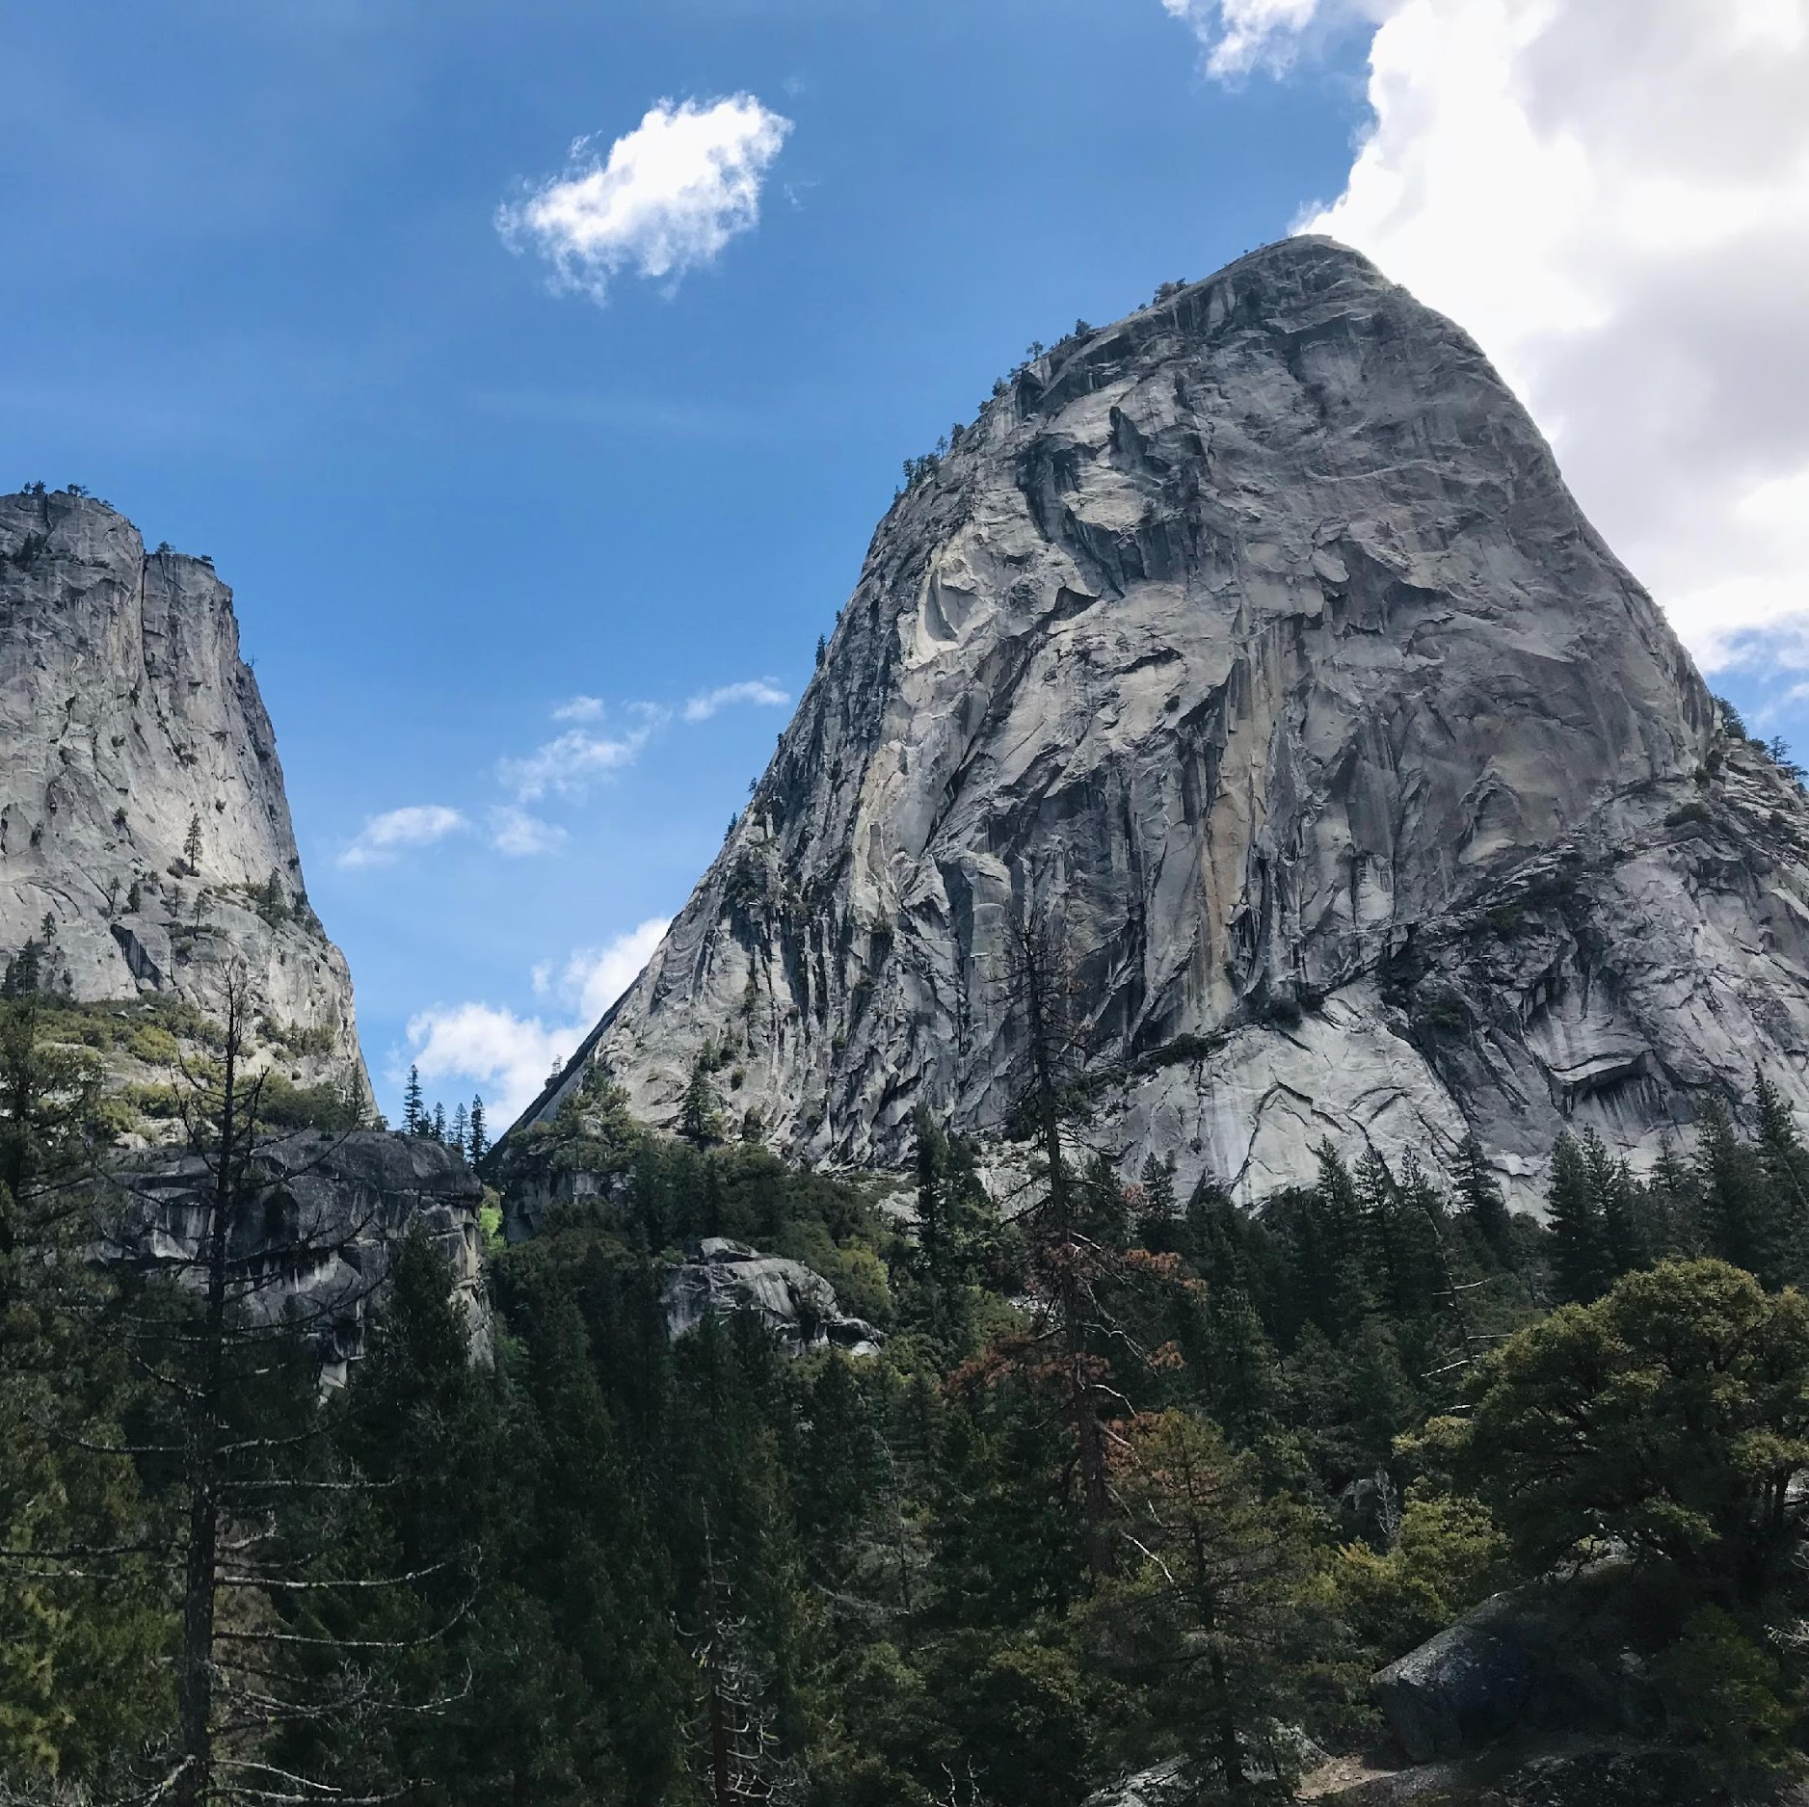
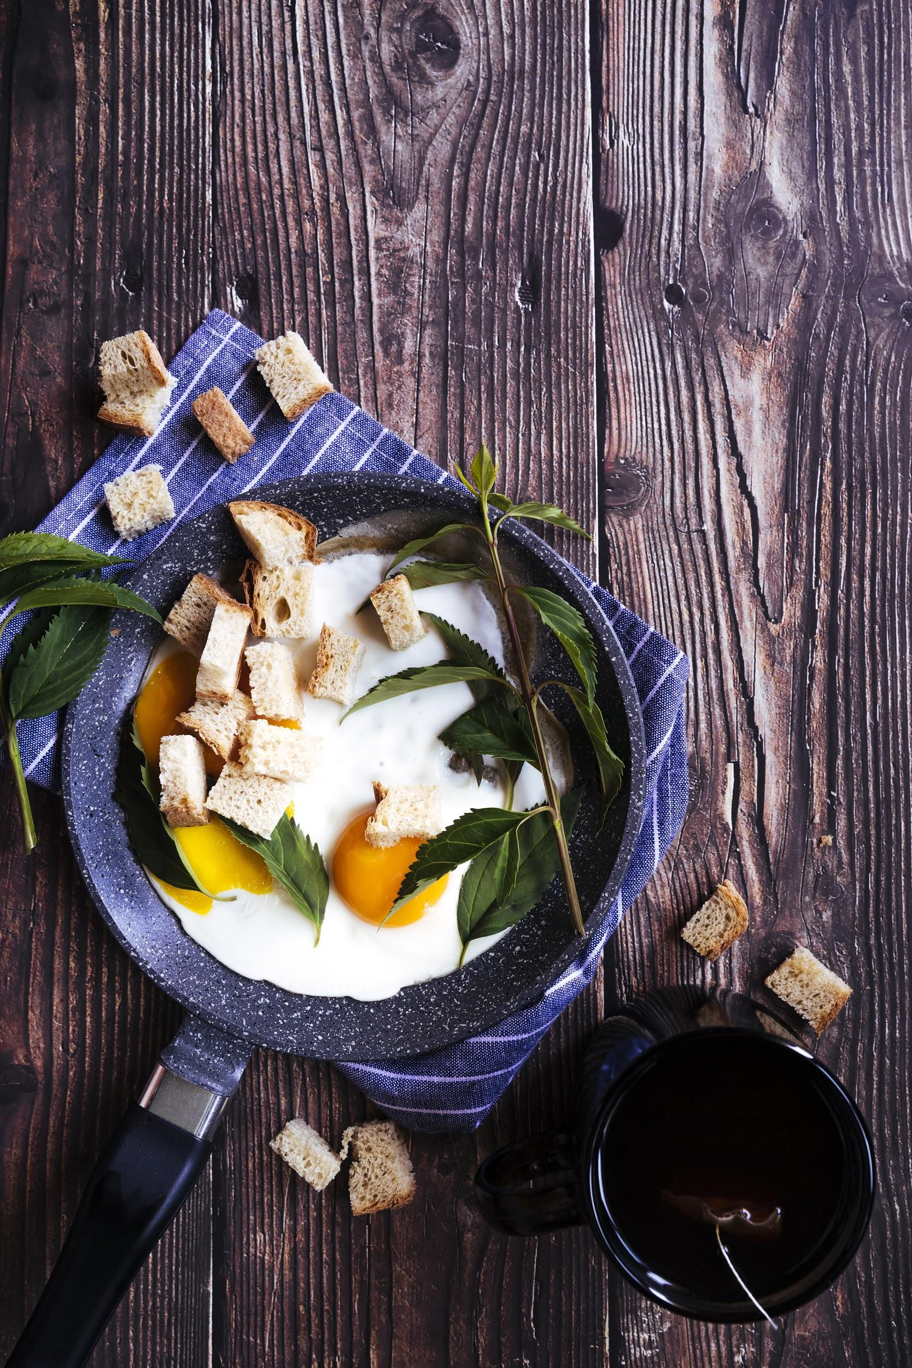
HUNGRY HUNGRY HIKERS
Josh, Kelsie, & Shuo

Slide 2
TABLE OF CONTENTS
ELEVATOR PITCH
01
04
CONCEPT
PROCESS
02
05
DEMO
FUTURE DEVELOPMENT
03
06
DEPLOYED APP
All about our product
Our inspiration
How the magic happened
Walkthrough
What’s next for Hungry Hungry Hiker?
Thank you!

Slide 3
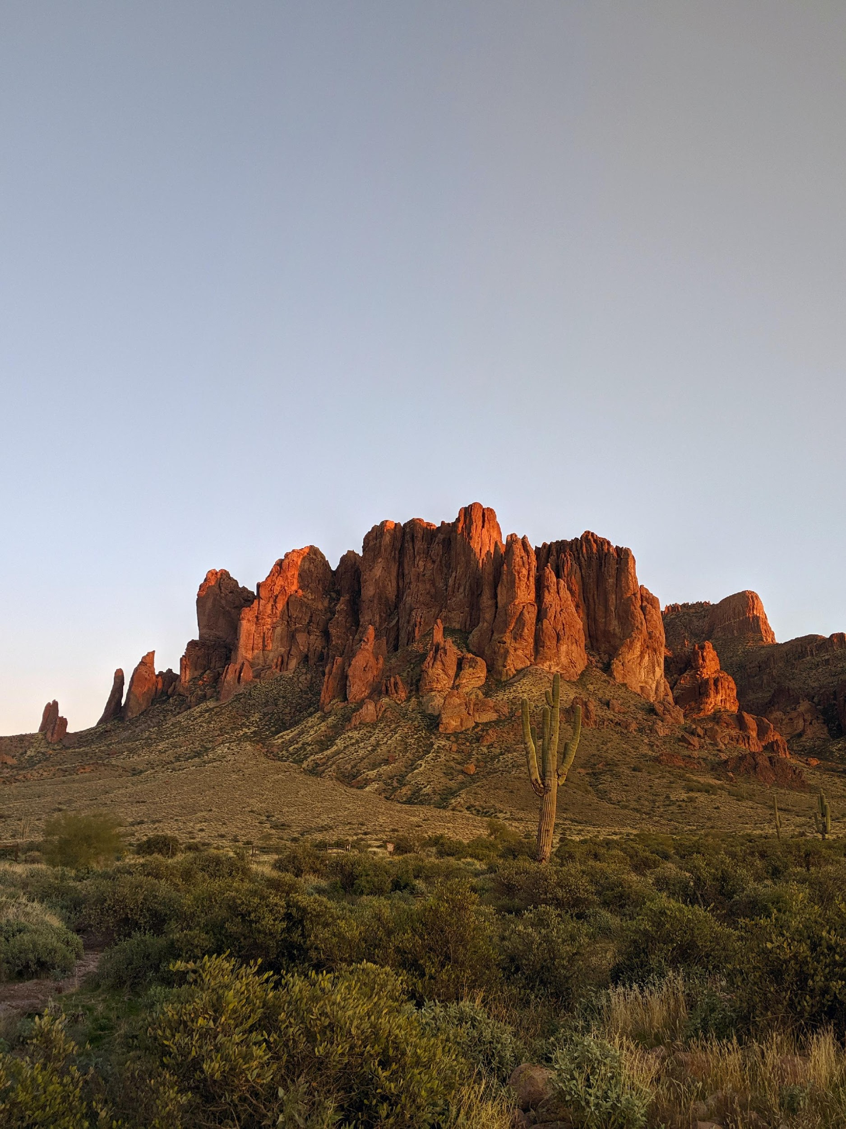

ELEVATOR PITCH
"It's a race, it's a chase, hurry up and feed their face!
Who will win? No one knows! Feed the hungry hik-er-ss!
Hungry hungry hikers!
(open up and there it goes!)"
YOUR LOGO

Slide 4



CONCEPT
IDEATION
NATIONAL PARKS
YELP
As avid National Parkivists we know how important it is to stay fueled and hydrated while wandering through the wilderness.
There are over 400 National Parks in the U.S. and they are visited by more than 230M people a year.
Helping users stayed fueled by personal experiences to help businesses uncovering hidden gems in the vast nature of it all.

Slide 5
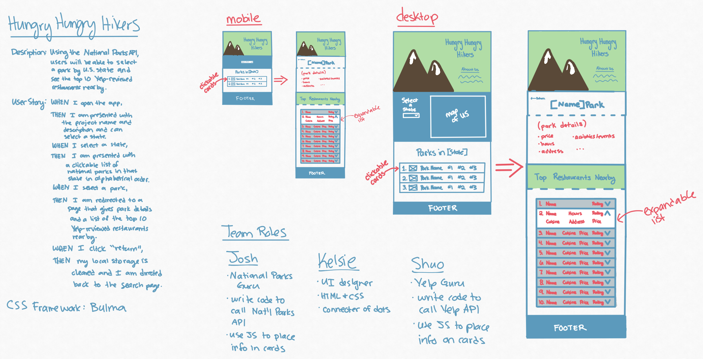
PROCESS

Slide 6
KEY ACTION ITEMS
 | PROJECT START | MID | FINAL
Nat’l Parks API | Select & Research API | Become expert on API and start making test calls | Populate desired data on home page and 2nd page
Yelp API | Select & Research API | Become expert on API and start making test calls | Populate desired data in correct order on 2nd page
UI Design | Collaborate on MVP attributes & look-and-feel | Revise wireframe based on API research & team goals | Touch up HTML/CSS/JS features, buttons, etc.

Slide 7
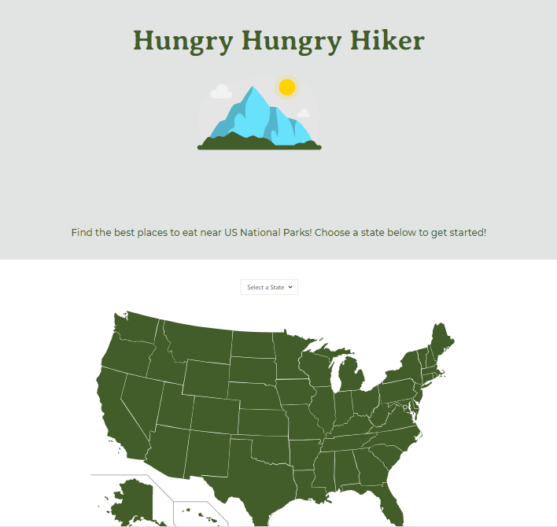
Demo
Our final product!
YOUR LOGO

Slide 8
FUTURE DEVELOPMENT
Favorites
Social Media
Add APIs
Goals
Saving favorites to make schedules for trips and things to do.
Plan out future expeditions.
Have an option for users to add their own pics
Add APIs to show nearby:
Airports
Car Rentals
Hotels
Airbnbs
Allow users to list how many parks they want to visit

Slide 9
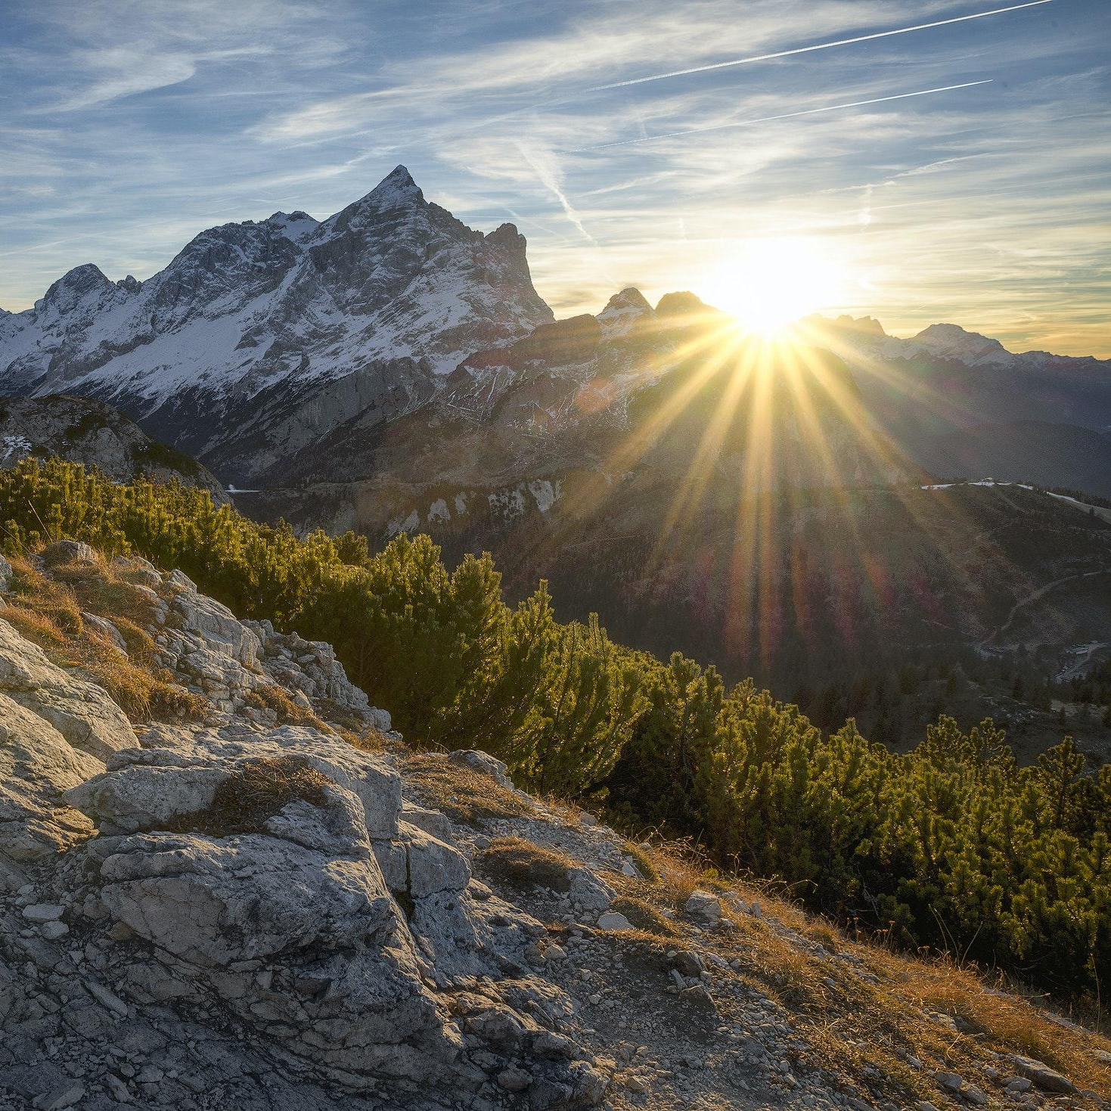
THANKS
Shout out to the TAs and Sam our Teacher.
We are learning more and more each day.
One day we will exceed our future goals.
https://kelsie-c.github.io/national-parks/index.html

Slide 10
CREDITS
This is where you give credit to the ones who are part of this project.
Presentation template by Slidesgo
Icons by Flaticon
Infographics by Freepik
Images created by Freepik - Freepik
Author introduction slide photo created by Freepik
Text & Image slide photo created by Freepik.com

